Slide 1


Murat Çelik
15.01.2023

Slide 2

Outline
Executive Summary
Introduction
Methodology
Results
Conclusion
Appendix

Slide 3
Executive Summary
Summary of methodologies
Data were extracted, analyzed and pre-processed.
The rocket to be sent with the space rocket data were analyzed.
It has been studied with many different data such as the success status, reusability and weight of the rockets sent.
Detection of missing data, use of SQL, data analysis and inferences were made.
Summary of all results
GridSearchCV is used. Logistic regression, Support Vector Machine, Decision Tree, K Nearest-Neighbor models were used. The results are close to each other. The overall result is 83.3%.

Slide 4
Introduction
By working with space rocket data, operations were made on it. Which rockets are reusable, their weight and various information and flight successes are defined.
Due to the diversity of data, different problems can be addressed. Different problems such as launch cost, location of first standing, reusability and success can be addressed.

Slide 5

Section 1

Slide 6
Methodology
Executive Summary
Data collection methodology:
Worked with spacexdata. First of all, the main data was drawn with the json data. Afterwards, additional operations were performed on the data with request commands. JSON and Request methods are learned.
Perform data wrangling
Missing data was checked, data analysis was performed to generate new columns.
Perform exploratory data analysis (EDA) using visualization and SQL
Perform interactive visual analytics using Folium and Plotly Dash
Perform predictive analysis using classification models
We divided the data into train and test. Then we gave it to the model. We analyzed it with the confusion matrix and compared the scores.

Slide 7
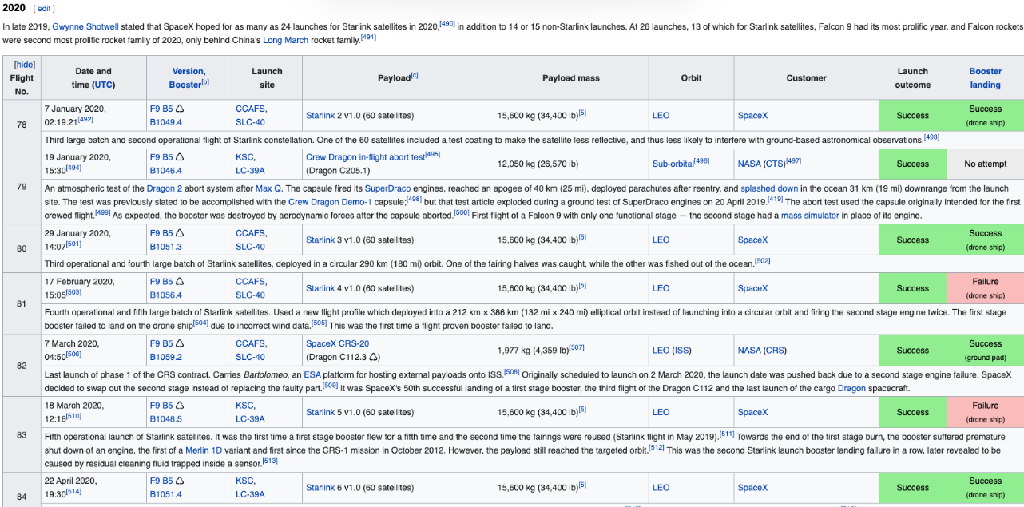
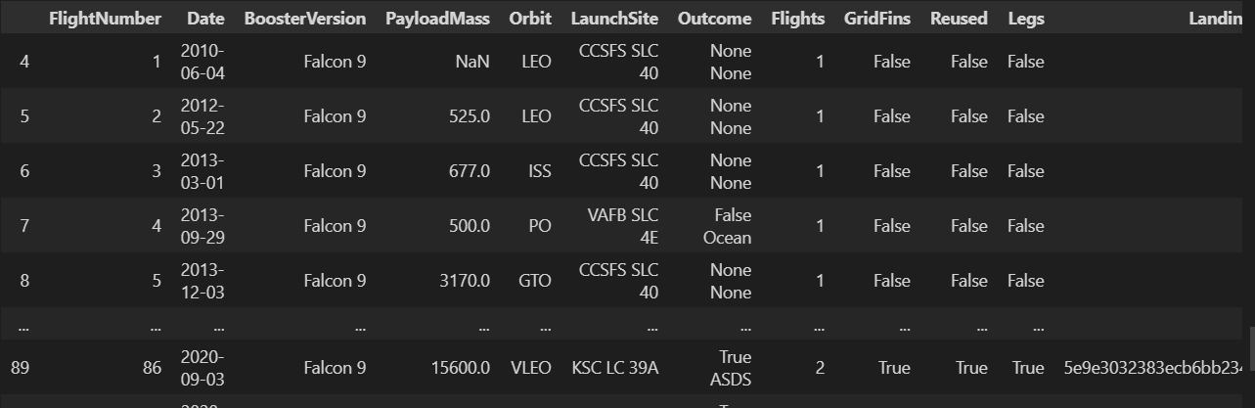
Data Collection
Worked with SpaceX REST API and Wikipedia,List of Falcon 9 and Falcon Heavy launches, data. Data was taken with request and worked with various columns.

Slide 8
Data Collection – SpaceX API
https://github.com/MuratCelik3506/IBM-DSCP/blob/main/Week1/jupyter-labs-spacex-data-collection-api.ipynb
Request data from SpaceX REST API
The data is corrected and finalized.
Missing data in the data is analyzed.
Missing data is preprocessed.

Slide 9
Data Collection - Scraping
https://github.com/MuratCelik3506/IBM-DSCP/blob/main/Week1/jupyter-labs-webscraping.ipynb
Request data from Wikipedia
Separate the incoming data with html parse.
Edit the split data and create a table.
Save table data.
9

Slide 10
Data Wrangling
1) Data are analyzed.
1.1) The content of the data is checked.
1.2) The number of contents in the data is checked.
1.3) The types of data are checked.
2) Landing column is added using outcome data.
3) Save the new data.
https://github.com/MuratCelik3506/IBM-DSCP/blob/main/Week1/labs-jupyter-spacex-Data%20wrangling.ipynb

Slide 11
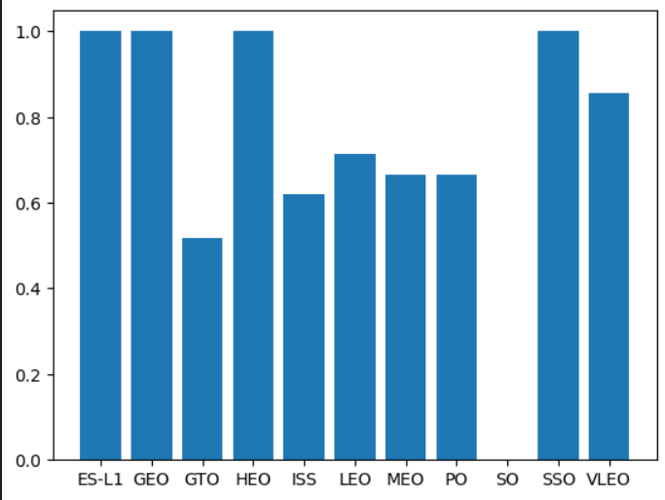
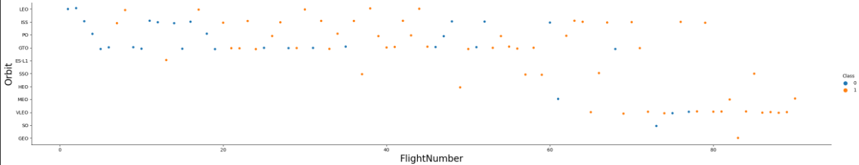
EDA with Data Visualization
Different graphics such as catplot, barchart, lineplot were drawn. These are tools that make it easy for us to analyze the data
Flight Number vs. Payload Mass, Flight Number vs. Launch Site, Payload Mass vs. Launch Site, Orbit Type vs. Success Rate, Flight Number vs. Orbit Type, Payload Mass vs Orbit Type and Success Rate Yearly Trend
https://github.com/MuratCelik3506/IBM-DSCP/blob/main/Week2/jupyter-labs-eda-dataviz.ipynb

Slide 12
EDA with SQL
Display the names of the unique launch sites in the space mission
Display 5 records where launch sites begin with the string 'CCA’
Display the total payload mass carried by boosters launched by NASA (CRS)
Display average payload mass carried by booster version F9 v1.1
List the date when the first succesful landing outcome in ground pad was acheived.
List the names of the boosters which have success in drone ship and have payload mass greater than 4000 but less than 6000
List the total number of successful and failure mission outcomes
List the names of the booster_versions which have carried the maximum payload mass. Use a subquery
List the records which will display the month names, failure landing_outcomes in drone ship ,booster versions, launch_site for the months in year 2015.
Rank the count of successful landing_outcomes between the date 04-06-2010 and 20-03-2017 in descending order.
https://github.com/MuratCelik3506/IBM-DSCP/blob/main/Week2/jupyter-labs-eda-sql-coursera_sqllite.ipynb

Slide 13
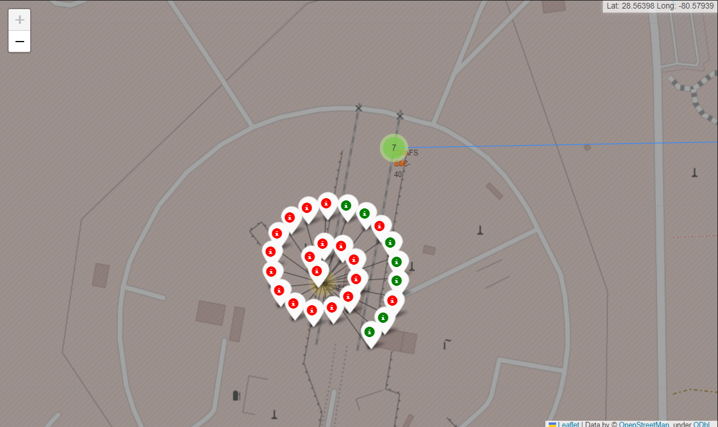
Build an Interactive Map with Folium
https://github.com/MuratCelik3506/IBM-DSCP/blob/main/Week3/lab_jupyter_launch_site_location.ipynb
Markers, circles, lines and marker clusters were used with Folium Maps
• Markers indicate points like launch sites;
• Circles indicate highlighted areas around specific coordinates, like NASA Johnson Space
Center;
• Marker clusters indicates groups of events in each coordinate, like launches in a launch site;
and
• Lines are used to indicate distances between two coordinates.

Slide 14
Build a Dashboard with Plotly Dash
The following graphs and plots were used to visualize data
• Percentage of launches by site
• Payload range
• This combination allowed to quickly analyze the relation between payloads
and launch sites, helping to identify where is best place to launch according
to payloads.

Slide 15
Predictive Analysis (Classification)
Edit data with numpy data.
Sclae the data with StandartScaler.
Split the data into train and test.
https://github.com/MuratCelik3506/IBM-DSCP/blob/main/Week4/SpaceX_Machine%20Learning%20Prediction_Part_5.ipynb
Choose a model. And set its different parameters.
Determine the best result.
Test the model on data and draw conclusions.
Train the model with the best parameters with Gridsearch.
Logistic regression, support vector machine, decision tree classifier, k nearest neighbors

Slide 16
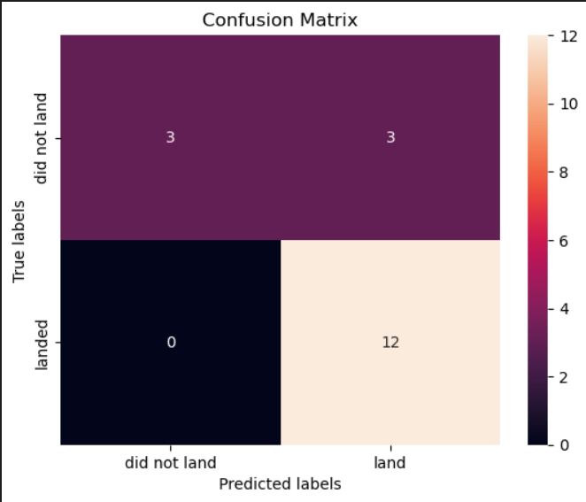
Results
Exploratory data analysis results
Score : 0.8333333333333334
Predictive analysis results

Slide 17

Section 2

Slide 18
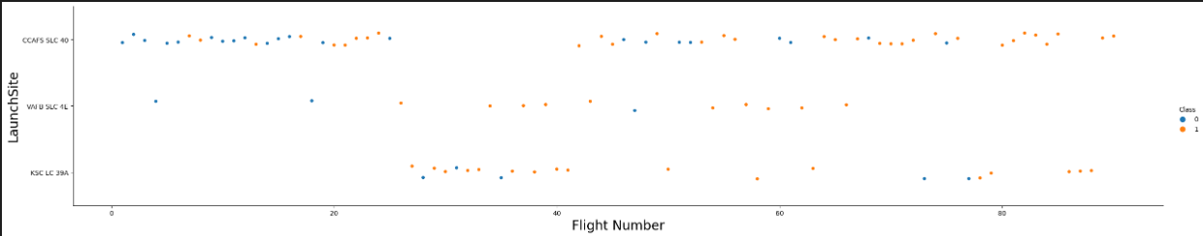
Flight Number vs. Launch Site
According to the plot above, it’s possible to verify that the best launch site nowadays is CCAF5 SLC 40, where most of recent launches were successful
VAFB SLC 4E and KSC LC 39A have higher success rates.

Slide 19
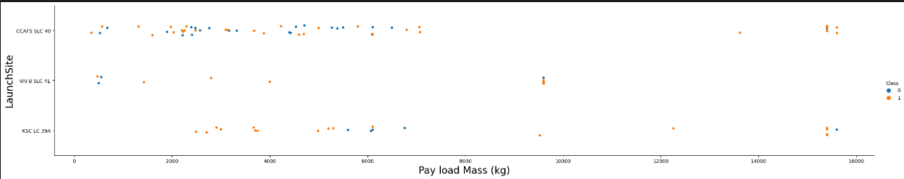
Payload vs. Launch Site
Most of the launches with payload mass over 7000 kg were successful.
Payloads over 12,000kg seems to be possible only on CCAFS SLC 40 and KSC LC 39A launch sites.

Slide 20
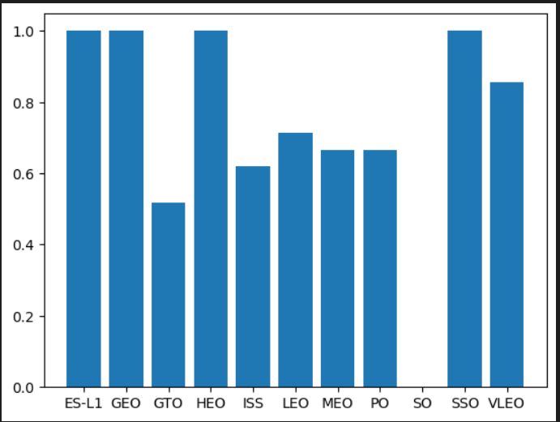
Success Rate vs. Orbit Type
Explanation: • Orbits with 100% success rate: - ES-L1, GEO, HEO, SSO • Orbits with 0% success rate: - SO • Orbits with success rate between 50% and 85%: - GTO, ISS, LEO, MEO, PO

Slide 21
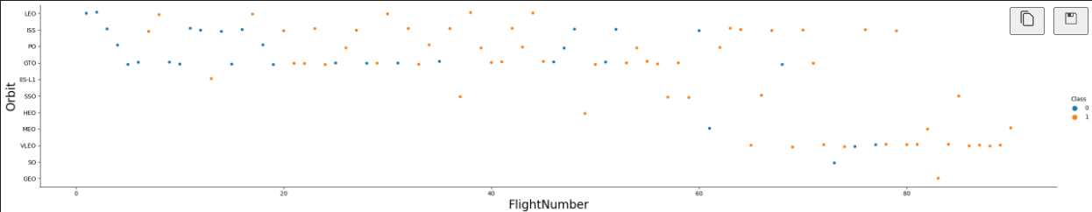
Flight Number vs. Orbit Type
LEO orbit the Success appears related to the number of flights
VLEO orbit seems a new business opportunity, due to recent increase of its frequency.

Slide 22
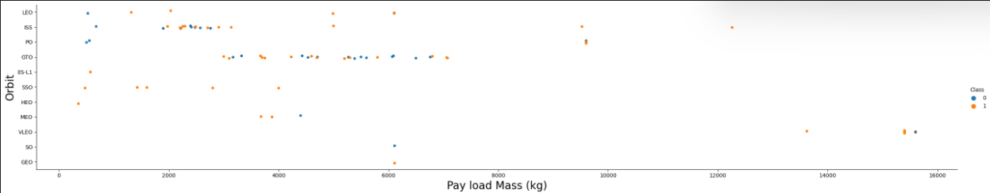
Payload vs. Orbit Type
Heavy payloads have a negative influence on GTO orbits and positive on GTO and Polar LEO (ISS) orbits.
There are few launches to the orbits SO and GEO.

Slide 23
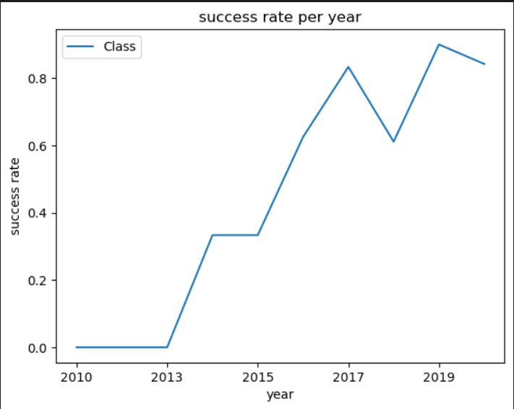
Launch Success Yearly Trend
Show a line chart of yearly average success rate
Show the screenshot of the scatter plot with explanations

Slide 24
All Launch Site Names
Displaying the names of the unique launch sites in the space mission.

Slide 25
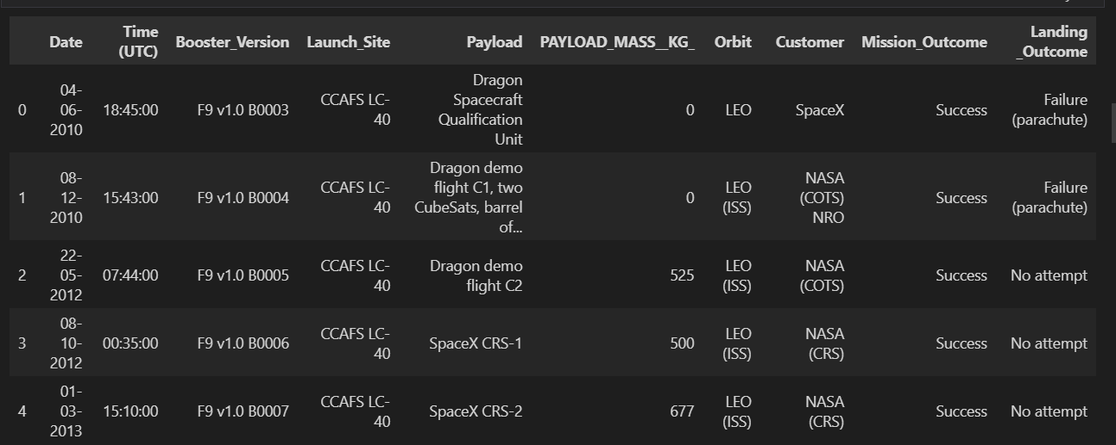
Launch Site Names Begin with 'CCA'

Slide 26
Total Payload Mass
45596

Slide 27
Average Payload Mass by F9 v1.1
2928.4

Slide 28
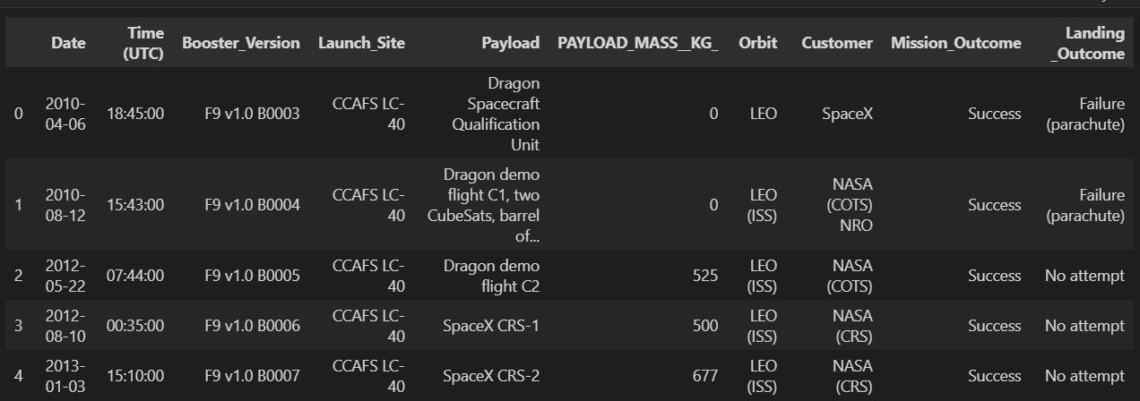
First Successful Ground Landing Date

Slide 29
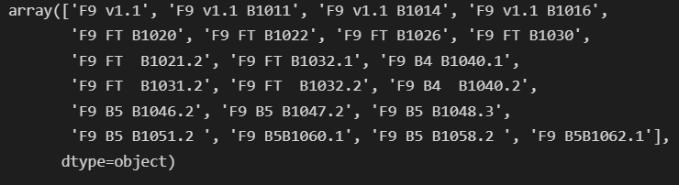
Successful Drone Ship Landing with Payload between 4000 and 6000

Slide 30
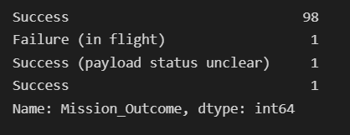
Total Number of Successful and Failure Mission Outcomes

Slide 31
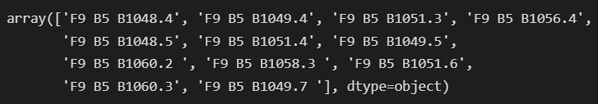
Boosters Carried Maximum Payload

Slide 32
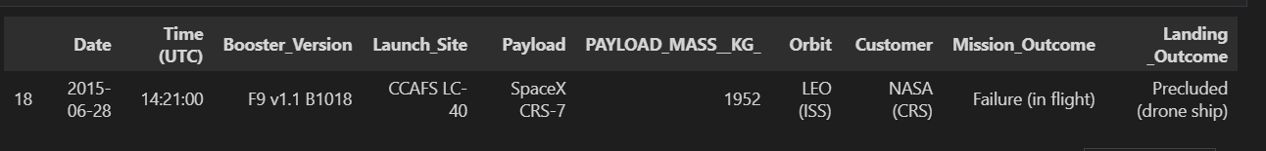
2015 Launch Records

Slide 33
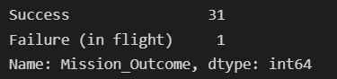
Rank Landing Outcomes Between 2010-06-04 and 2017-03-20

Slide 34

Section 3

Slide 35
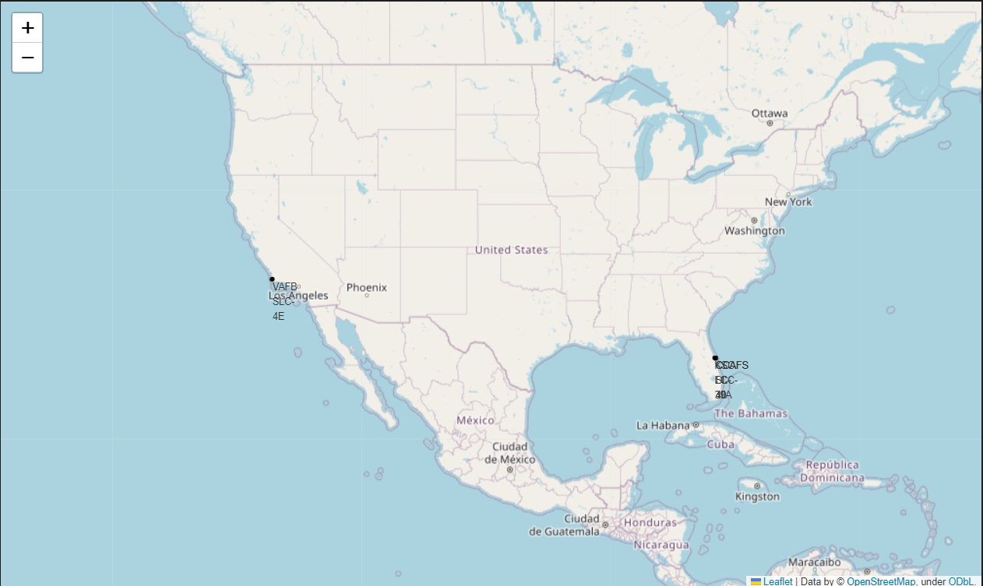
All launch sites

Slide 36
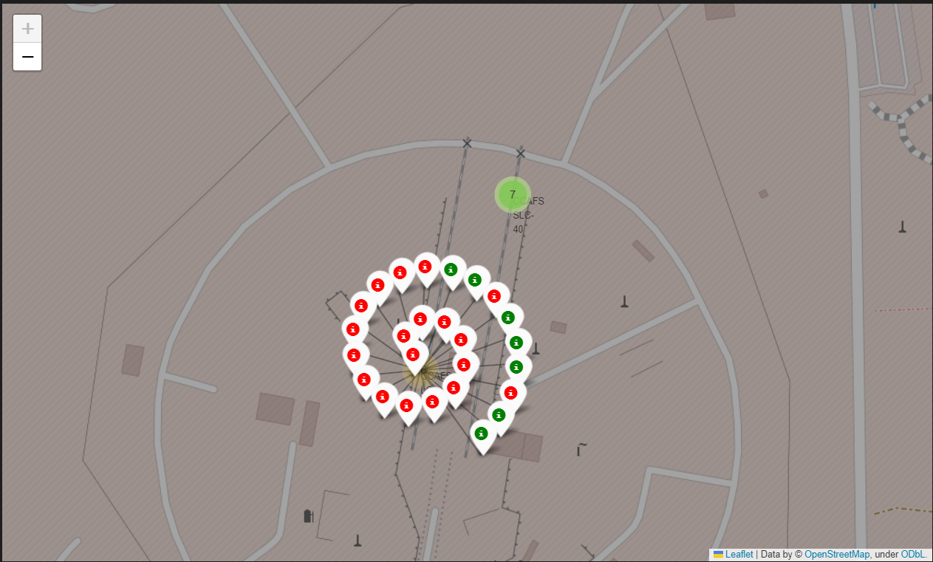
Colour-labeled launch records on the map
Green Marker = Successful Launch - Red Marker = Failed Launch

Slide 37
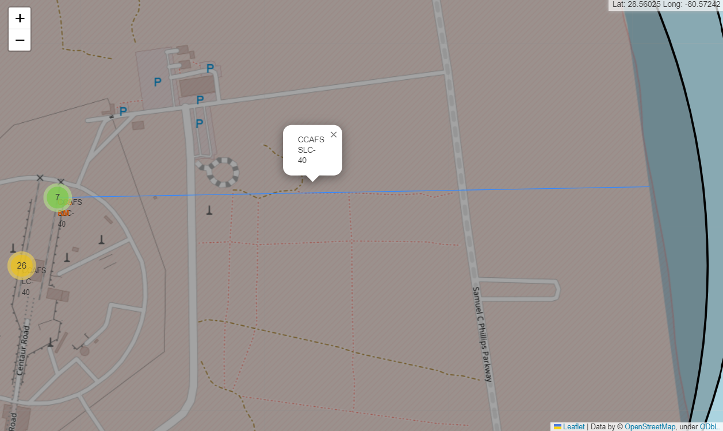
Distance from the launch site

Slide 38

Section 4

Slide 39
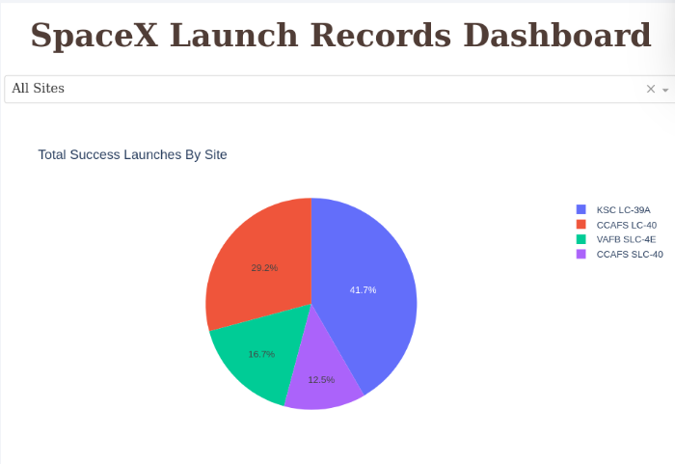
Successful Launches by Site
Being successful has a close relationship with the landing position.

Slide 40
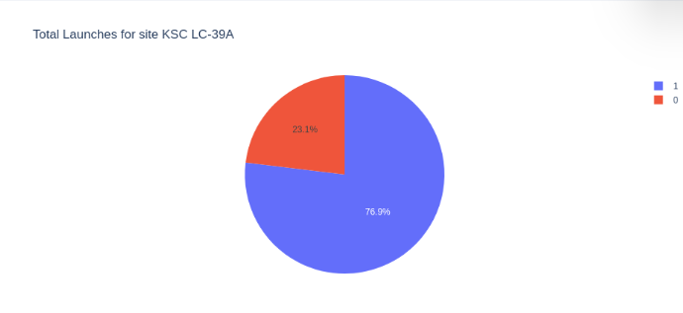
Launch Success Ratio for KSC LC
76.9% of launches are successful in this site.

Slide 41
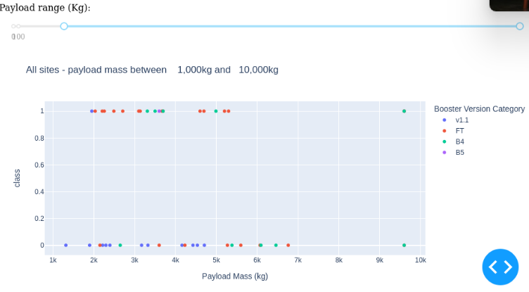
Payload Mass vs. Launch Outcome for all sites
The charts show that payloads between 2000 and 5500 kg have the highest success rate.

Slide 42

Section 5

Slide 43
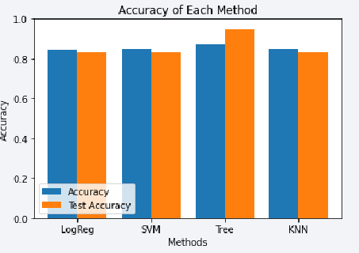
Classification Accuracy
Score : 0.8333333333333334
K nearest neighbors
Decision tree classifier
Support vector machine
Logistic regression

Slide 44
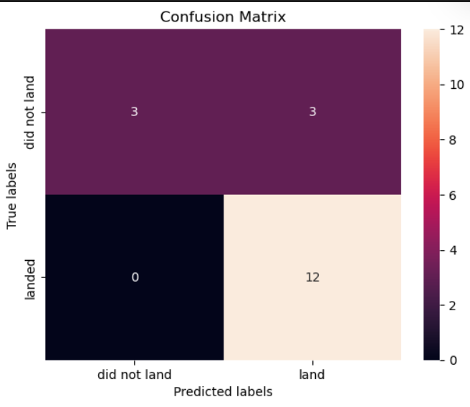
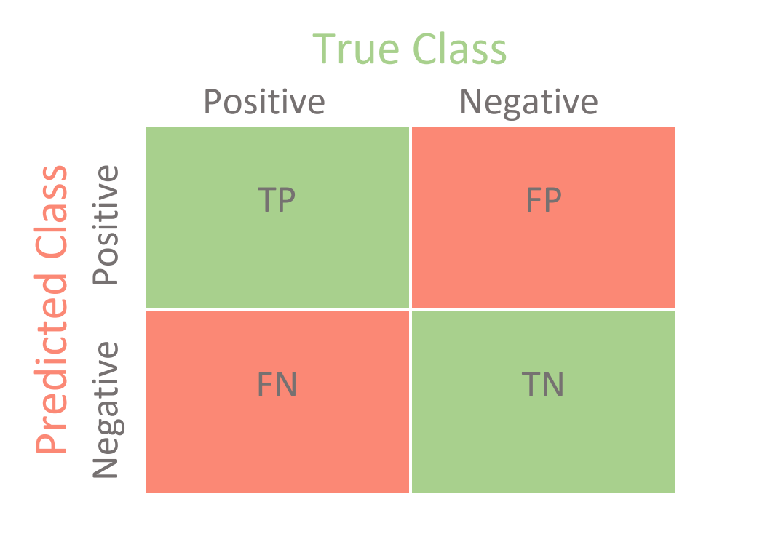
Confusion Matrix
Examining the confusion matrix, we see that logistic regression can distinguish between the different classes. We see that the major problem is false positives.

Slide 45
Conclusions
Different data sources were analyzed, refining conclusions along the process;
The best launch site is KSC LC-39A;
Launches above 7,000kg are less risky.
Most of launch sites are in proximity to the Equator line and all the sites are in very close proximity to the coast.
Orbits ES-L1, GEO, HEO and SSO have 100% success rate.
Although most of mission outcomes are successful, successful landing outcomes seem to improve over time, according the evolution of processes and rockets;
I think, Support Vector Machine can be used to predict successful landings and increase profits.

Slide 46
Appendix
https://www.coursera.org/
https://www.w3schools.com

Slide 47


